Slide 1
Frontend Testing 2020

Slide 2

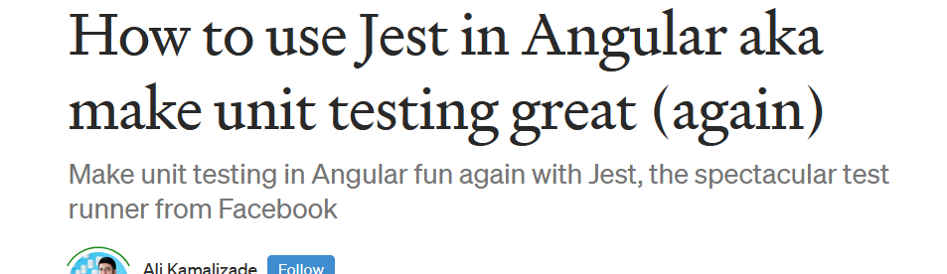
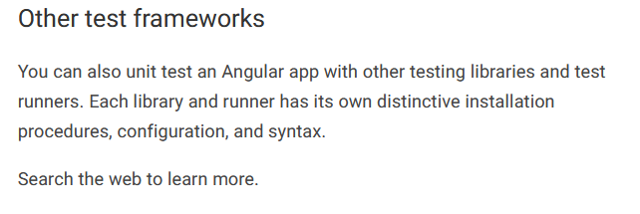


Quelle: Angular Docs

Slide 3
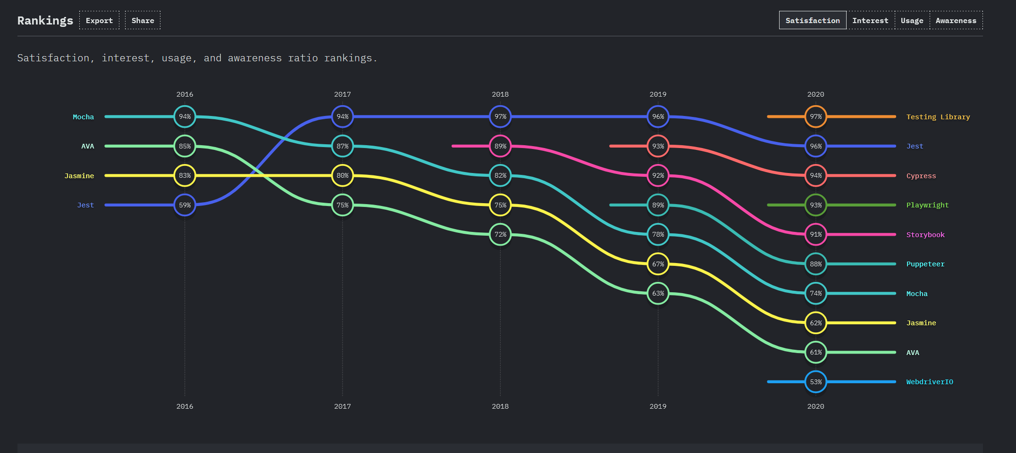
https://2020.stateofjs.com/en-US/technologies/testing/
Notes:
https://2020.stateofjs.com/en-US/technologies/testing/

Slide 4
Inhalt
Jasmine (Angular Testing Default)
Jest
(Angular) Testing Library
Evtl. Cypress

Slide 5
Quellen
https://github.com/testing-library/angular-testing-library/tree/master/apps/example-app/app/examples
tbd

